Slide 1
Consumer Rights & Confidentiality Training
Friday, March 11, 2022

Slide 2
foundations
NC General Statute 122-C
MH/DD/SA Rules APSM 30-1
Consumer Rights Rules APSM 95-2

Slide 3
Core competencies/ client rights
Foundations of Client Rights
Touch and Consent
Abuse and Neglect
Therapeutic Relationships
Confidentiality Rules & HIPAA

Slide 4
Consumer Rights
Right
to dignity
Right
to privacy
Right
to humane care
Right
to freedom from mental/physical abuse, neglect, exploitation
Right
to treatment
Right
to age-appropriate treatment
Right
to an individualized written treatment plan

Slide 5
Consumer Rights Continued
Right
to have access to medical care
Right
to be informed in advance of potential risks/benefits of program choices
Right
to confidentiality
Right
to consent to/refuse treatment
Right
to be free from unnecessary or excessive medications
Right
to be informed of emergency procedures

Slide 6
Consumer Rights Continued
Right
to be free from threat or fear of unwarranted supervision or expulsion
Right
to be free from unwarranted search and seizure
Right
to exercise all civil rights
Right
to file a grievance or complaint
Right
to appeal

Slide 7
Chatham trades policy
Assure basic human rights to each consumer.
The rights of consumers will not be restricted without due process.

Slide 8
Chatham trades procedures
Confidentially of Information
Proper release of confidential information
Appropriate access to confidential information by the staff, consumer and others
Each consumer will have an individualized written service plan
Refrain as much as possible from physical restraints/seclusion
Consumer can refuse treatment at any time

Slide 9
Procedures continued
No excessive/unnecessary medication
No physical/emotional/verbal abuse of consumers
No threats
Force only for restraint in emergency situations
Consumers’ lockers are private space
Consumers entitled to phone calls in private

Slide 10
Procedures continued
Staff may search a consumer only under certain conditions and must be authorized by the Executive Director
Parents/guardians must be notified of any searches
Staff shall not engage in any romantic or sexual discussions or behaviors with consumers
Staff are prohibited from engaging in business transactions with consumers

Slide 11
Procedures continued
Staff prohibited from borrowing assets or property from consumers
Staff prohibited from asking consumers to perform tasks for them or members of their family
Staff shall not give or receive gifts of a substantial nature to/from consumers

Slide 12
Procedures continued
All consumers have the right to file a grievance
All consumers will be informed of the due process for filing a grievance at the time of admission
Resolve issues with Hab. Tech./Unit Supervisor
Address with Vocational Services Coordinator or Quality Assurance Manager then Executive Director
Board of Directors
LME/MCO Client Rights Committee
Disability Rights North Carolina

Slide 13
Procedures continued
Consumers will be given a written copy of their rights
Staff are required to explain rights to consumers
Staff are required to explain any rules consumers are expected to follow
All new staff shall receive information about the rights of consumers and engage in periodic trainings

Slide 14
Touch and consent
con·sent
/kənˈsent/
noun
permission for something to happen or agreement to do something.
verb
give permission for something to happen.

Slide 15
Everyone has the right to consent everyone has the right to say no
Hugs
Handshakes
Fist Bumps
Arms Around Shoulders
Back/Shoulder Rubs
Kisses
Playing with Hair
Poking
Pats on the Shoulder/Back
Pats on the Head
Laying Head on Shoulders
Patting on Bottom

Slide 16
Therapeutic touch
Benefits the consumer
Performed for a specific reason
Proven to work
Approved by Guardian/Caregiver
May be documented in Behavior Plan or PCP/ISP
Only Performed by Staff

Slide 17
Abuse and neglect
Who do I report abuse, neglect, or exploitation to?
Immediately report to supervisor.
Supervisor will make a report to DSS, APS, and consumer’s case manager and an IRIS report will be filed.
Report will be filed within 24 hours.

Slide 18
Abuse and Neglect Continued
If you make a report your identity will not be disclosed without your consent except to investigator/prosecutor or when disclosure is legally compelled.
Employee making report in good faith is immune from any civil liabilities.
Staff have a duty to report under NC laws.

Slide 19
Abuse and neglect continued
What is reported?
Any suspected abuse of a client. You do not have to see the abuse, see any marks, or even be sure that the abuse took place.
Things to report: hitting, pushing, shoving, forcing food or medication, not giving food or medication, isolation, name calling, sexual abuse, any rights violations, etc.

Slide 20
Abuse and neglect continued
What if I see it happen?
Staff have a responsibility to intervene and prevent, if possible, any instance of abuse or neglect by anyone towards a consumer.
This does not negate your responsibility to report such abuse or neglect. If you see a co-worker being abusive and you approach them and discuss it, you still must make a report to your supervisor.

Slide 21
Confidentiality /hipAa
What is HIPAA?
The Health Insurance Portability and Accountability Act of 1996 began to help individuals keep their health insurance coverage as they moved from one job to another.

Slide 22
Confidentiality /hipAa
What we think of as HIPAA is only a small part (Title II) of this act, which protects privacy, confidentiality, integrity, and availability of an individual’s healthcare information.
In the past, there have been few or weak penalties for breaching confidential health information.
With the passage of the HITECH (Health Information Technology for Economic and Clinical Health) Act in 2009 as part of the American Recovery and Reinvestment Act, things have changed.

Slide 23
Confidentiality /hipAa
HITECH Act extends civil and criminal liability under HIPAA to business associates of other HIPAA covered entities, includes provisions for imprisonment of violators, and clarifies that criminal penalties may apply to an individual or employee of a covered entity that obtains PHI (protected health information) without authorization.
There is also a rule that any improper use or disclosure of PHI is presumed to be a breach unless it is proven that there was a low probability that the PHI was compromised.
Another rule determines whether patients, the government, and the media must be informed of any breaches of unsecured PHI.

Slide 24
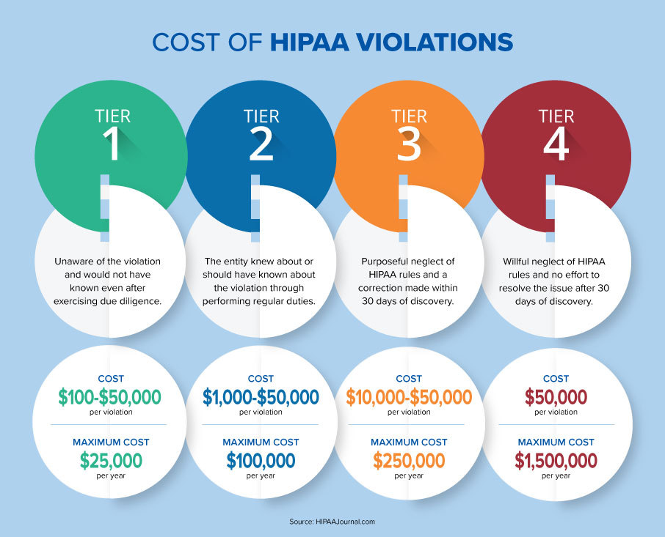

Slide 25
Confidentiality /hipAa
Confidential information cannot be released without a signed authorization of release (must be signed by consumer or consumer’s guardian)
If consumer is signing, must be told what the release is for and that they can withhold consent
Releases are good only for one year
People who can release information: Executive Director, Quality Assurance Manager, Vocational Services Coordinator, Office Manager
Release will be documented in consumer’s file

Slide 26
Confidentiality /hipAa
Shredding documents with full names on them.
Not leaving documents with full names where others can see them.
Not using full names in unsecure emails, texts, publications, notes that the public may see, etc.
Double lock any protected health information.
Don’t give out any information to someone you do not know over the phone.
If you are not sure, don’t do it until you find out if its OK.

Slide 27
Confidentiality /hipAa
Can we ever disclose information without consent?
When there is a medical or psychiatric emergency involving consumer health or safety or the safety of others.
When required by law to report instances of neglect or abuse of a child or disabled adult.
When responding to a court order or participating in a commitment proceeding.
When required by North Carolina Administrative Code to disclose physician information due to an incident that would cause health risk to other persons.
To the NC Department of Corrections.

Slide 28
Therapeutic Relationships
A therapeutic relationship is defined as “an interactive relationship with a patient and family that is caring, clear, boundaried, positive, and professional.
From: Pediatric Critical Care (Fourth Edition), 2011

Slide 29
What does a therapeutic relationship look like?
Boundaries
Consistency
Professional
Doing With
Clear Expectations
Accountability
Respectful
Adult : Adult

Slide 30
What happens when we have therapeutic relationships?
Trust
Security
Growth
Confidence

Slide 31
What does a therapeutic relationship NOT look like?
No Boundaries
Unmanaged
Doing For
Favoritism
Unclear Expectations
Inconsistent
Friendship/Paternal
Adult : Child

Slide 32
What happens when we don’t have therapeutic relationships?
Confusion
Behaviors
Frustration
Resentment

