Slide 1
Welcome to Chatham Trades!

Slide 2
Mission
Goals
Chatham Trades, Inc. is a private nonprofit organization dedicated to the employment and training for intellectually and developmentally disabled adults in Chatham County.
The primary objective of Chatham Trades is to assist individuals in attaining goals that enable them to function at their highest degree of self-sufficiency and to integrate into the community.
Chatham Trades, Inc. provides a choice of opportunities to meet the needs and desires of individuals with disabilities within our community by:
Providing diverse and innovative opportunities to improve the quality of life for persons served and the community.
Providing positive and rewarding alternatives and opportunities for growth and development.
Maximizing vocational opportunities.
Retaining and attracting talented, caring and experienced staff.
Linking persons served and families with resources in the community.
Enhancing our professional and community reputation.

Slide 3
Put Simply...
Chatham Trades provides an intellectually stimulating environment for personal growth, socialization, community involvement, skill development, employment and financial independence. Everyone needs to have a reason to get up in the morning, a place to go where they're needed and a skill that provides a sense of purpose and pride. These elements create a well-rounded, healthy individual, despite any disability.

Slide 4
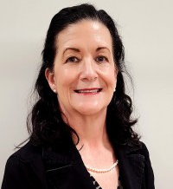
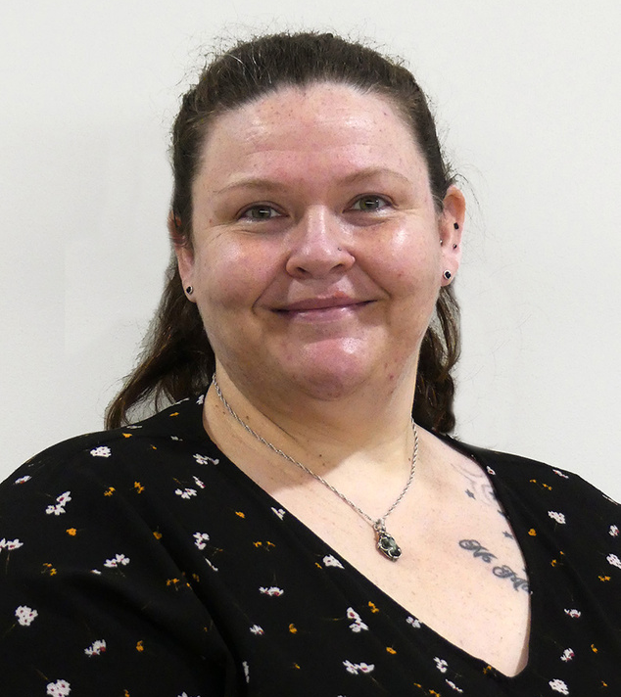
Shawn Poe
Meet The Administrative Team
Executive Director
Jessica Godfrey
Quality Assurance Manager

Slide 5
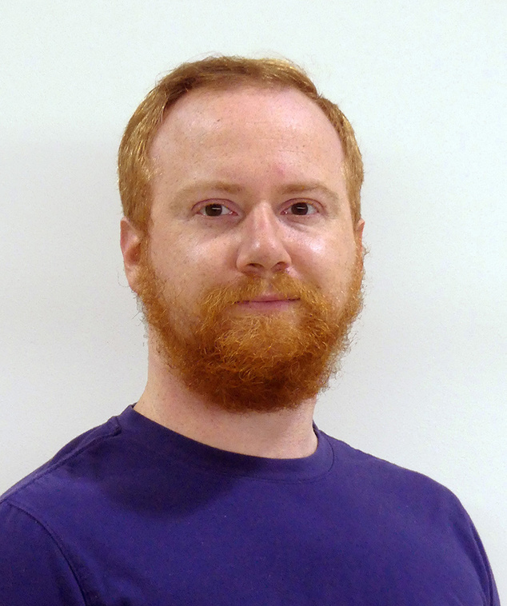
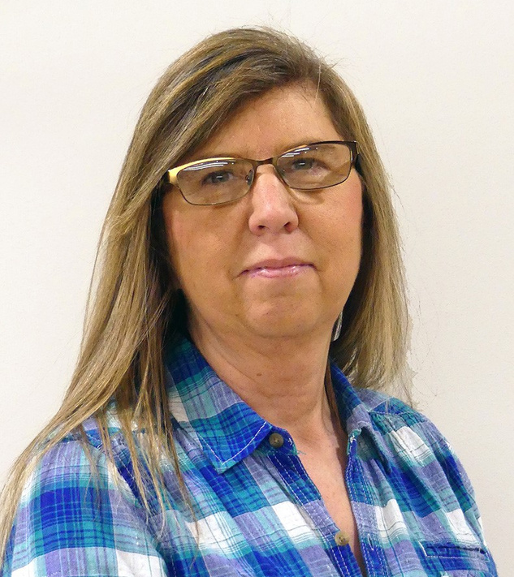
Patrick Kelly
The Administrative Team
Vocational Services Coordinator
Bonita Smith
Production Manager

Slide 6
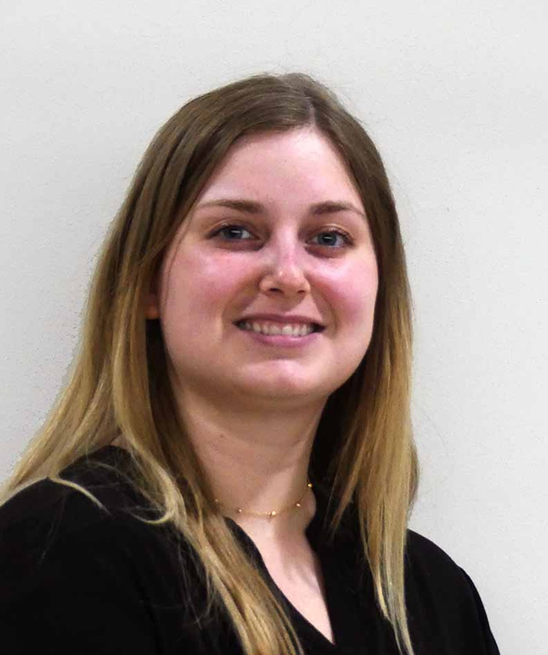
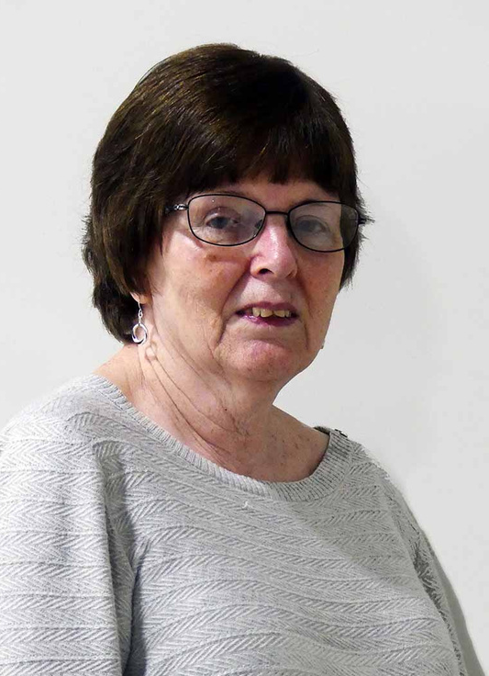
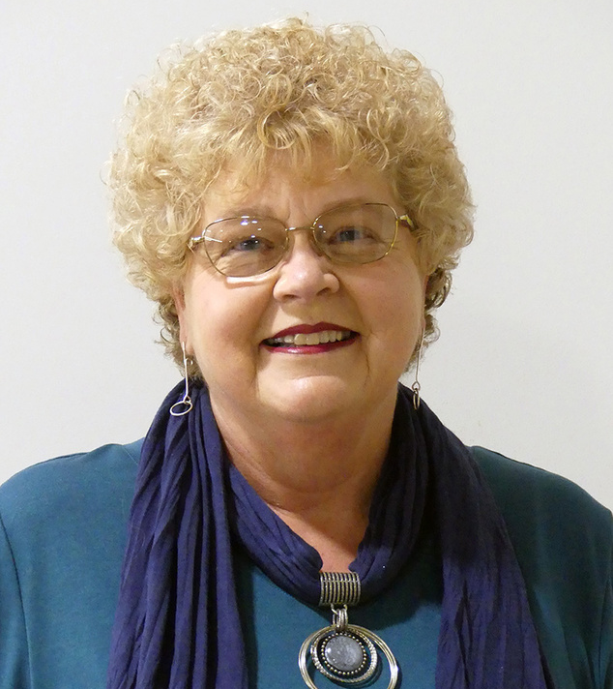
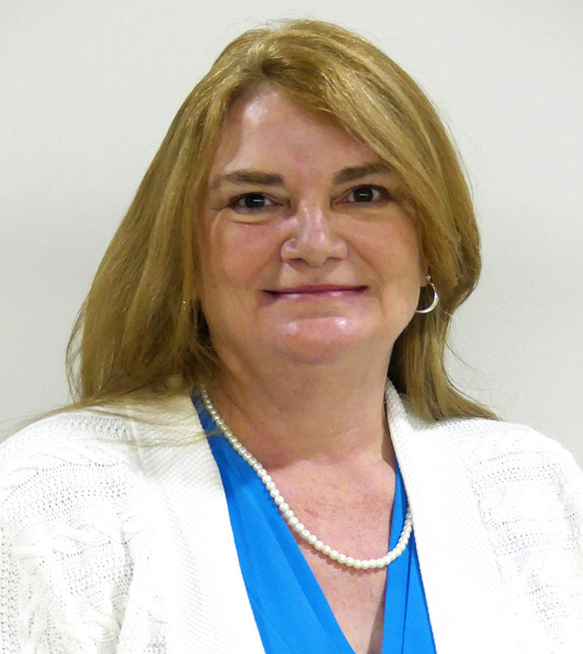
Allison Armstrong
Elaine Dixon
The Administrative Team
Office Manager
Administrative Assistant
Meet our leaders
Dina Reynolds
Pam Roberts
Director of Development and Communications
Executive Administrative Assistant

Slide 7
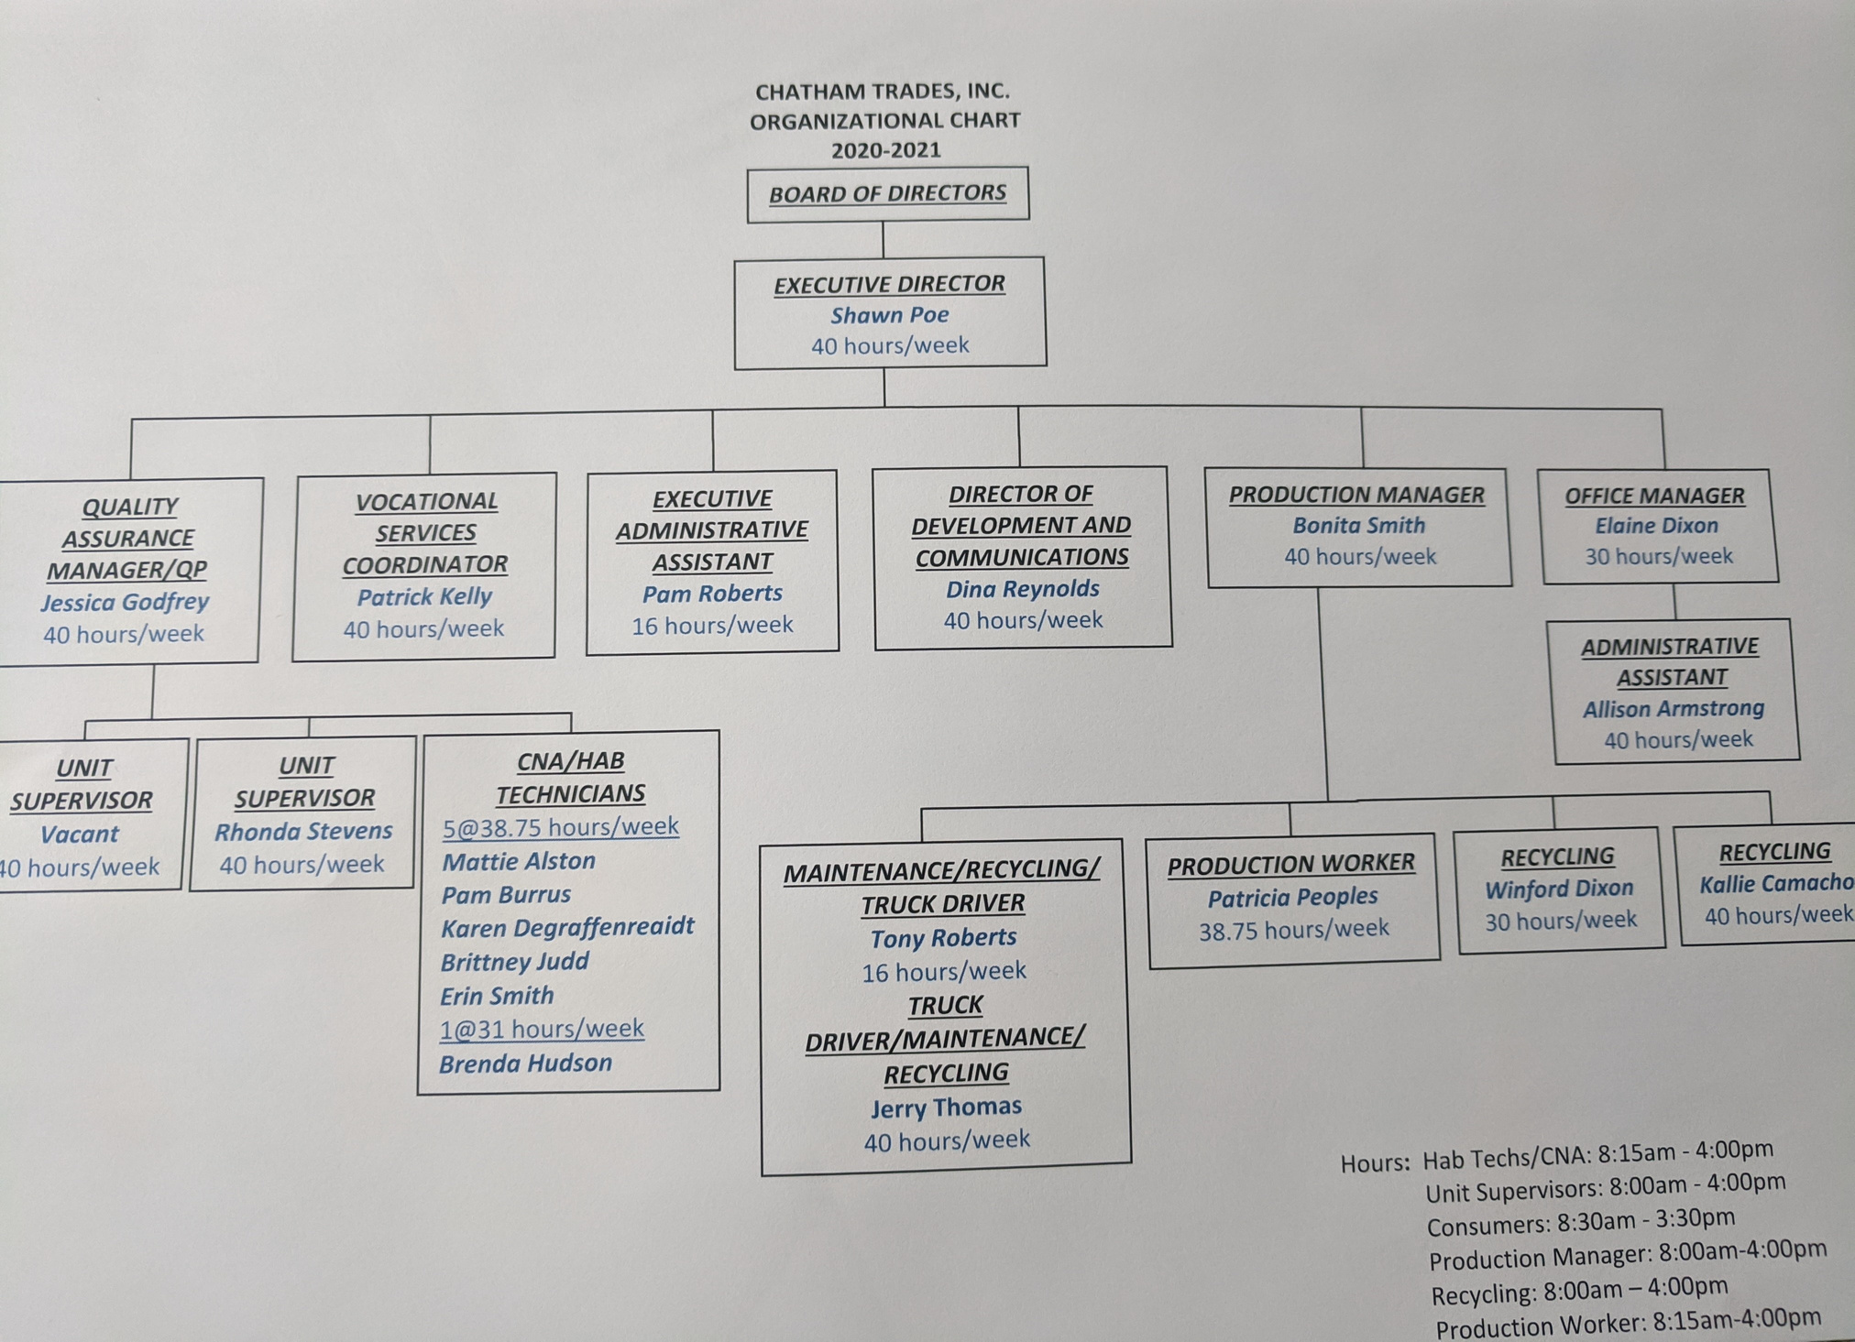

Slide 8
Verification of Credentials
R|R
Depending upon the position, verification of credentials may be accomplished by one or more of the following primary methods:
Verification
of Previous Employment
Drivers License
Record Check
Educational
Transcripts
Test
for Proficiency
NC Nurse Aide I & Health Care Personnel Registry Check
Criminal Record Check
Office of Inspector General Exclusion List

Slide 9
Probationary
Period
Employee
Training
All staff members in new positions undergo a six-month probationary period to determine whether or not they fully satisfy the requirements of the job. Supervisors will monitor job performance and give verbal feedback to the new staff member on a regular basis.
Chatham Trades has a thorough and extensive training program for all employees upon hiring. There are 28 different topics. Training is usually completed within the first 90 days of hire. See: chathamtrades.org/staff-training-page for a complete listing of the trainings.
Communications
Policy
Dress
Policy
The purpose of having electronic access is to support the consumer’s goals and instructional program, learning opportunities, information retrieval, searching strategies, research skills, critical thinking skills, and life-long learning. Chatham Trades’ computers and network must be used in a responsible, efficient and legal manner. See Network Acceptable Use Policy for the appropriate uses of devices and equipment.
Employees must wear sturdy, casual and comfortable work clothing. Halter tops, spaghetti straps tops and off-the-shoulder tops are not permitted. Open-toed and high-heel shoes are not permitted on the work floor. Shorts, no more than 3 inches above the top of the knee, may be worn. Dresses and skirts must reach the top of the knee in length. For jobs that pose a potential risk of injury, personal protective clothing (aprons, gloves, etc.) will be provided and must be worn. In addition, current COVID protocols require that all staff and consumers wear a face mask.

Slide 10
Work
Schedule
Reporting
For Work
All staff members in new positions undergo a six-month probationary period to determine whether or not they fully satisfy the requirements of the job. Supervisors will monitor job performance and give verbal feedback to the new staff member on a regular basis.
Each employee is responsible for notifying his or her supervisor at the earliest possible time if he or she is to be late or absent. Notification should be given no later than the beginning of the workday and must be done by phone call. Email or texts are not acceptable.
Overtime
Compensation
Pay
Schedules
Supervisors shall arrange the work schedule of their employees so as to accomplish the required work within the standard workweek. Employees work overtime only in unusual or emergency situations and with prior approval of their supervisor.
Overtime is paid to non-exempt employees for all hours worked in excess of 40 hours per week. The regular hourly rate will be paid for work through 40 hours. The rate is time-and-a-half for work over 40 hours.
The workweek is from Monday through Sunday. The staff is paid every other Thursday, in accordance with the pay schedule that is distributed annually. There are 26 pay periods per year.
Jury
Duty
Upon proof of services, staff members will be paid their regular wages for actual time served on jury duty.

Slide 11
Racial Equity Statement
Diversity, equity and inclusion are central to our mission and to our impact. Whether related to race, sex, ethnicity, religion, age, accessibility, neurodiversity, physical abilities or sexual orientation, we recognize that an inclusive and diverse work environment respects the unique characteristics, skills and experiences of all employees. To be engaged, one must feel included and valued. We strive to build and nurture a culture where differences are respected.

Slide 12
Medical Coverage
Life
Insurance
Full-time employees working 30 hours or more per week are offered health insurance. Employees pay a portion of the premium. The amount is determined by the Chatham Trades Board of Directors. It is currently $56 per pay period ($4 per day). The policy is currently Blue Cross/Blue Shield's Blue Options.
Full-time employees of 30 hours or more are offered a $15,000 life insurance policy at no cost to them.
Accidental
Death
Full-time employees of 30 hours or more are offered an accidental death and dismemberment policy at no cost to them.
Employee Benefits
Vision
Insurance
Full-time employees of 30 hours or more are offered vision insurance at no cost to them.
Supplemental
Insurances
Dental and AFLAC policies are paid by the employee and can be paid pre-tax through payroll deduction.

Slide 13
Vacation
Leave
Sick
Leave
The amount of annual leave is based on a staff member's hours worked per week and the length of employment. Please see page 7 of the Personnel Policies for more details.
Sick leave is earned at the rate of 12 days per year (8 hours per month) for staff members working 40 hours per week. Accrual of sick leave for employees working less hours is pro-rata.
Employee Benefits
Holidays
& Birthdays
All staff receive 11 paid holidays per year. In addition, all staff receive a paid holiday for their birthday, which may be used at any time during the year with supervisor approval.

Slide 14
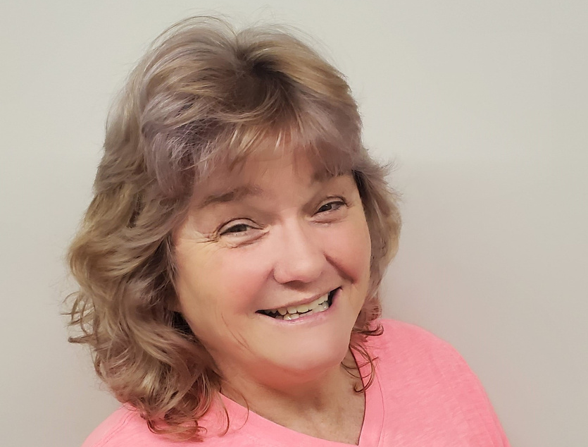
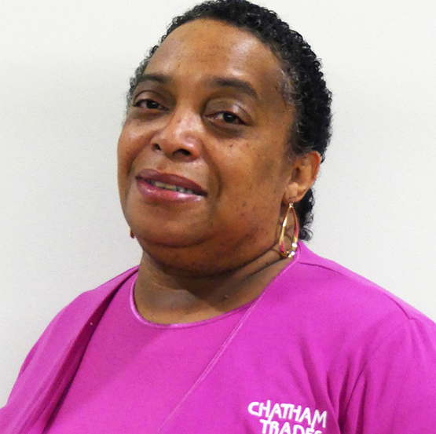
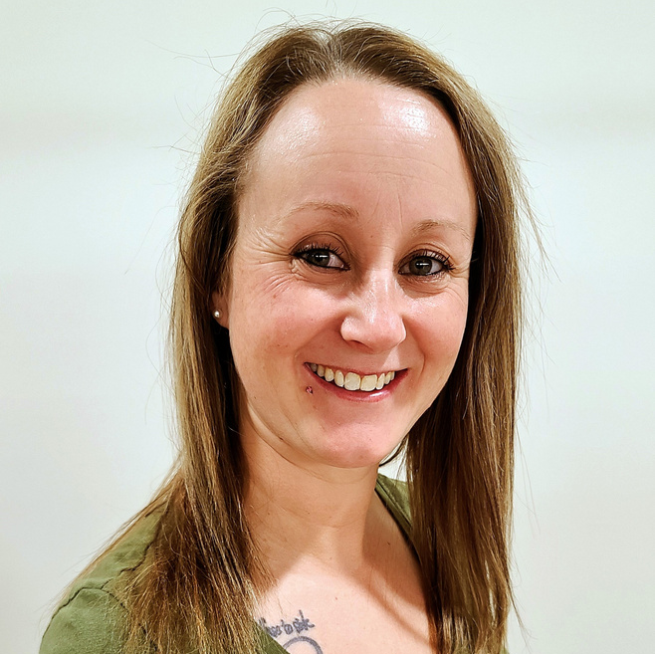
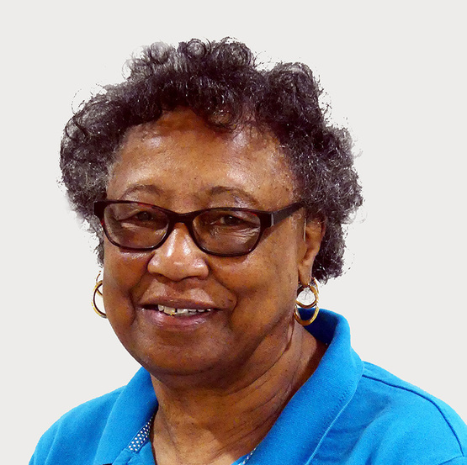
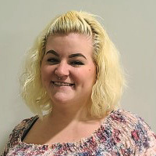
Welcome to the Chatham Trades family!
Rhonda
Karen
Brittney
Erin
Pam
Mattie

Slide 15
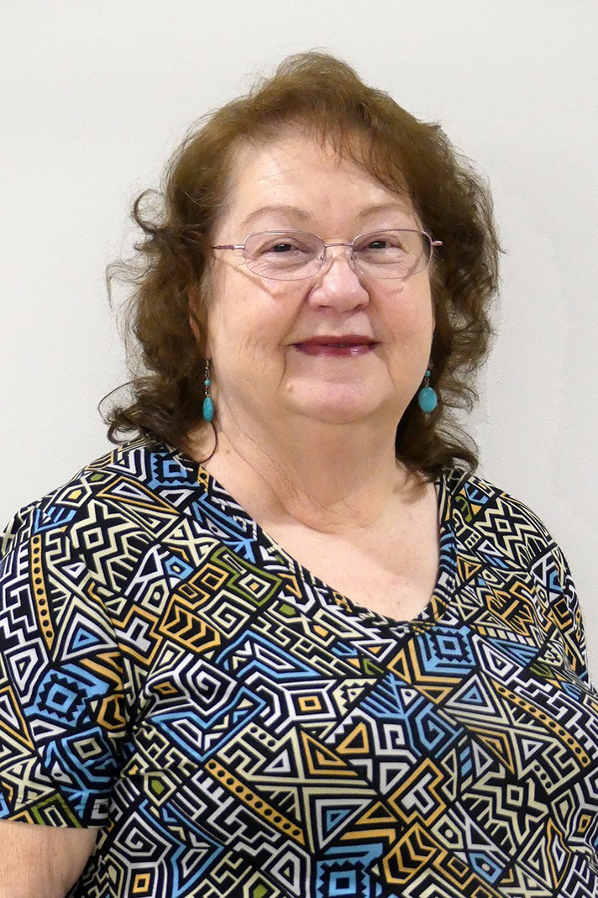
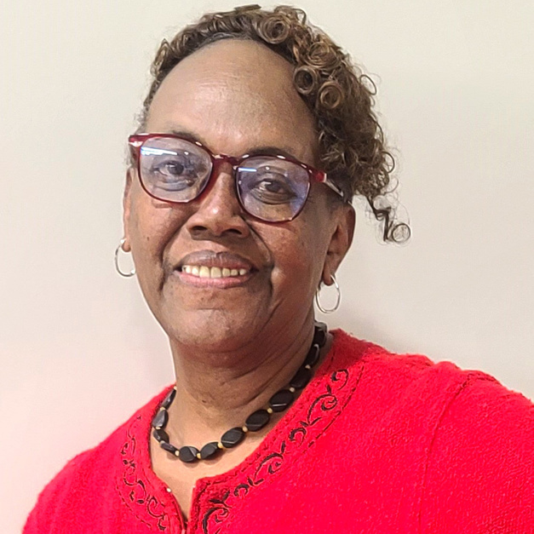
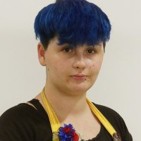
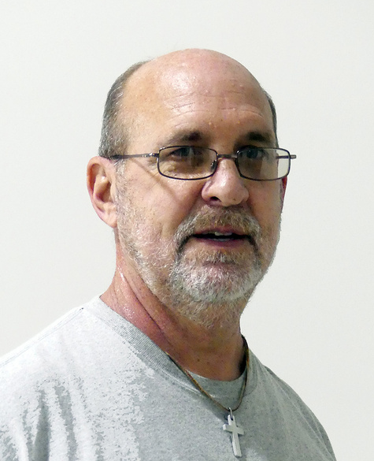
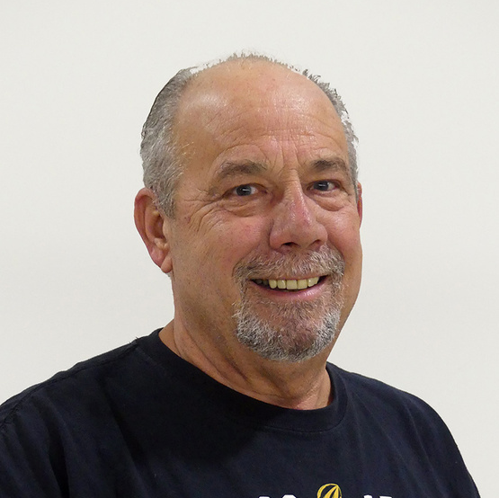
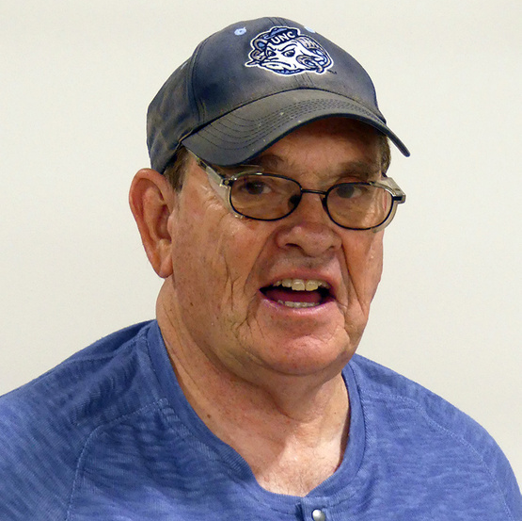
Welcome to the Chatham Trades family!
Brenda
Patricia
Winford
Kallie
Tony
Jerry

Slide 16
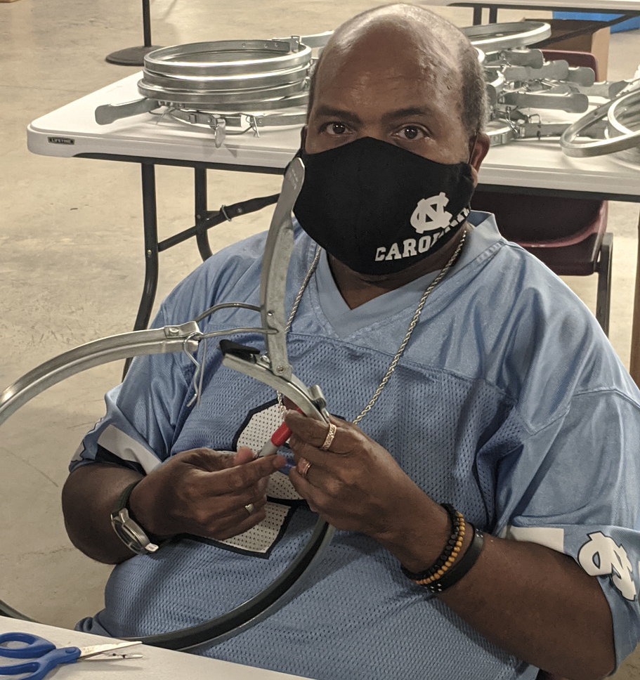
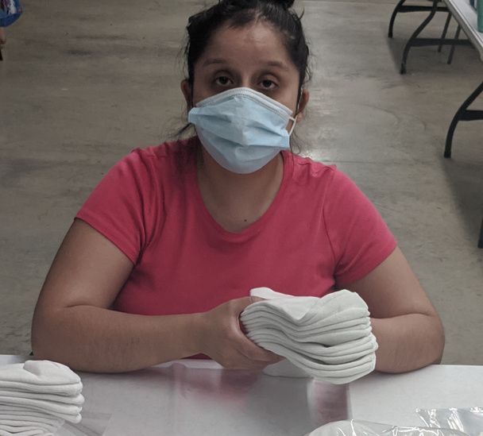
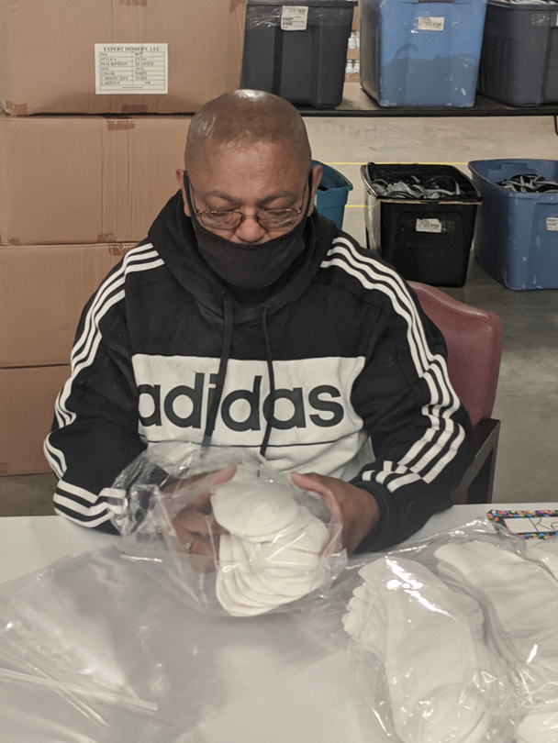
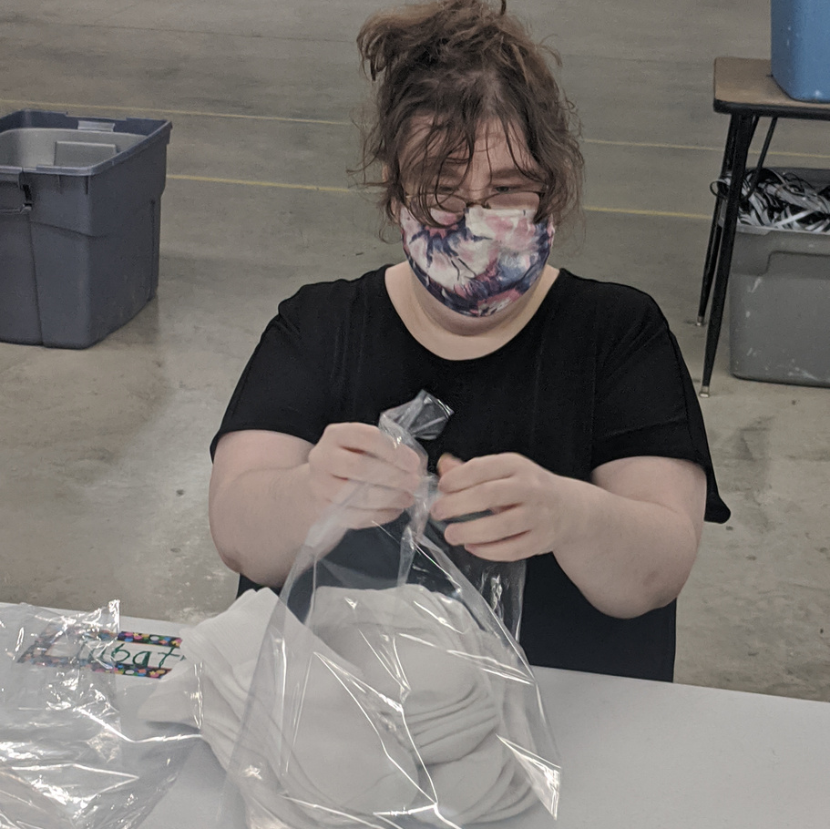
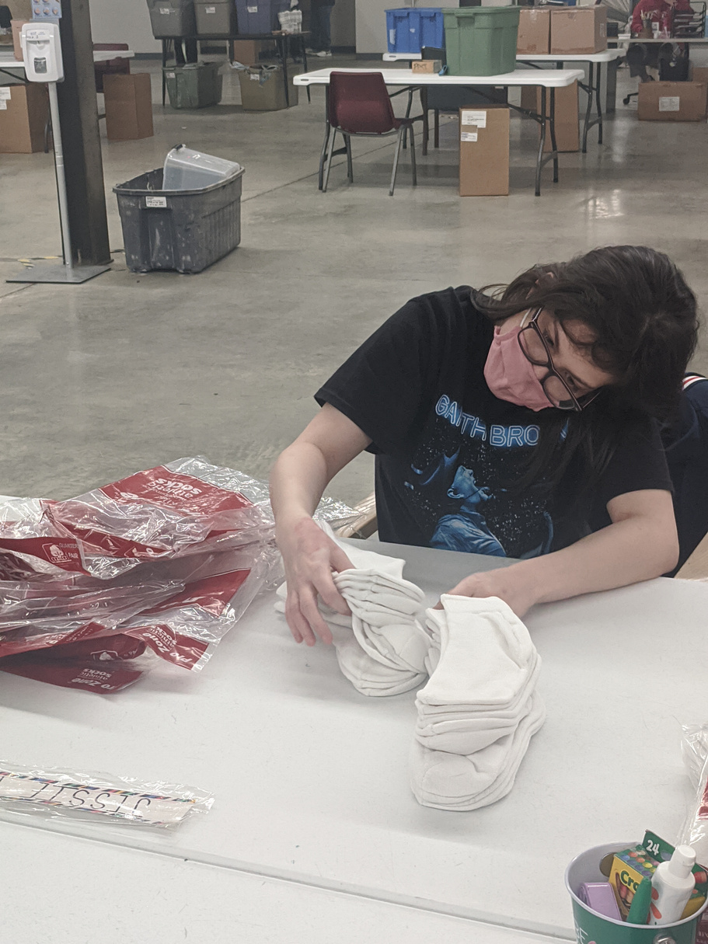
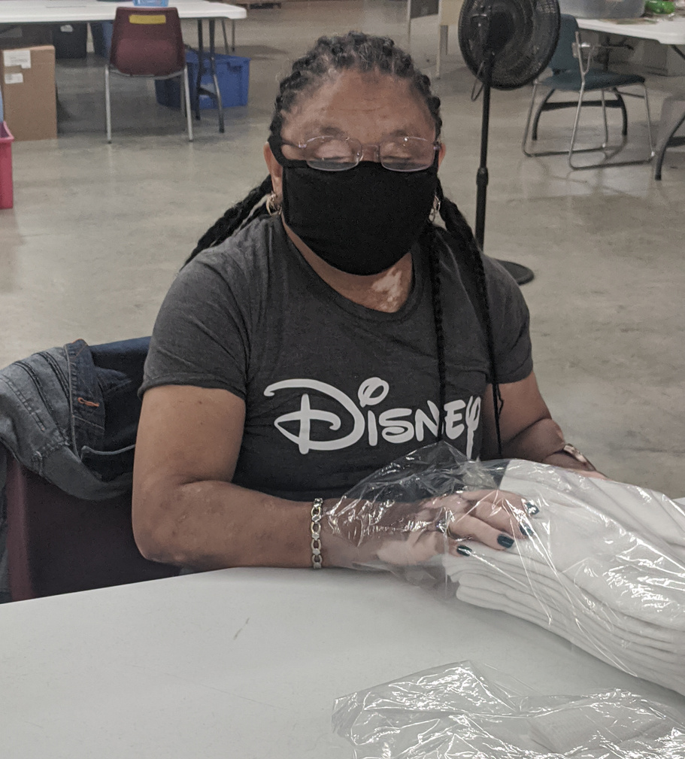
Welcome to the Chatham Trades family!
Robert
Jessica
Kenny
Jessie
Zenaida
Rose
Tabitha

Slide 17
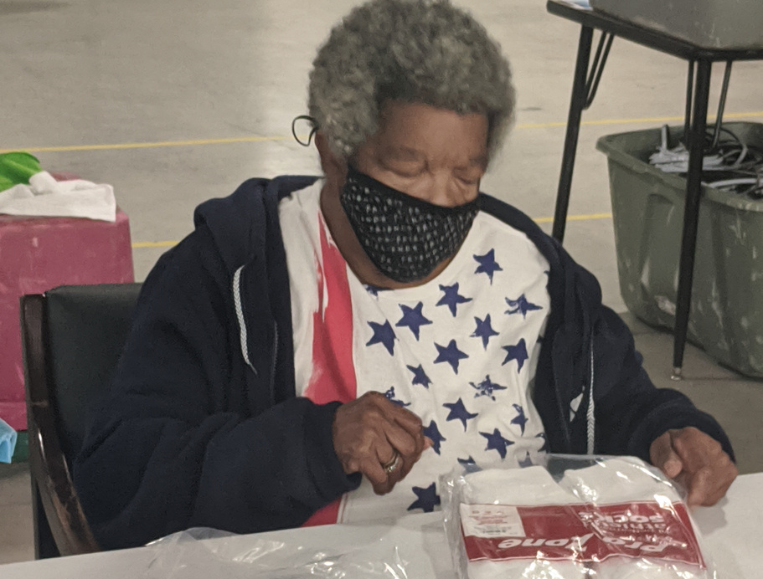
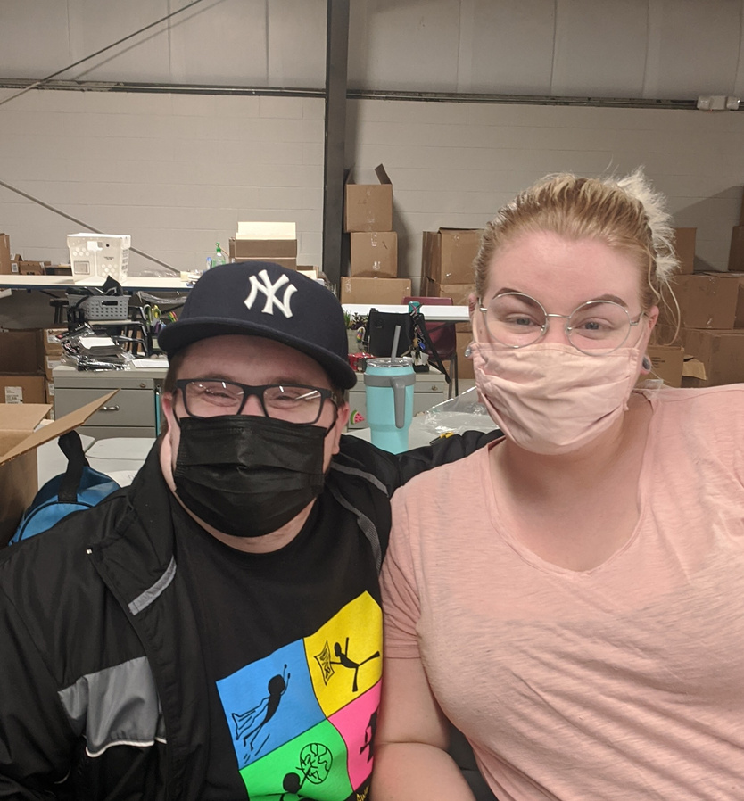
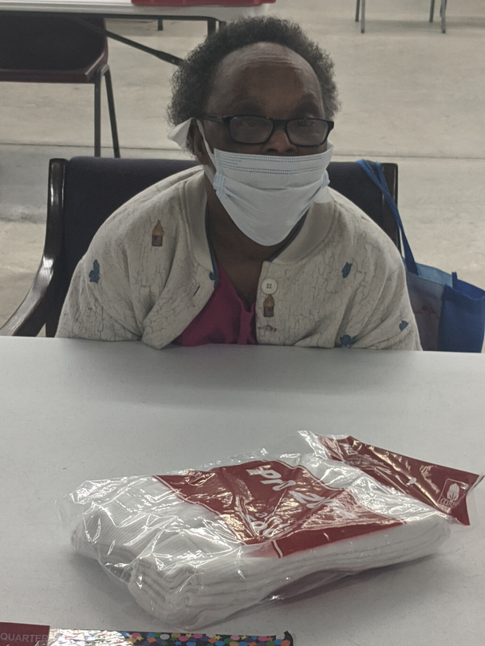
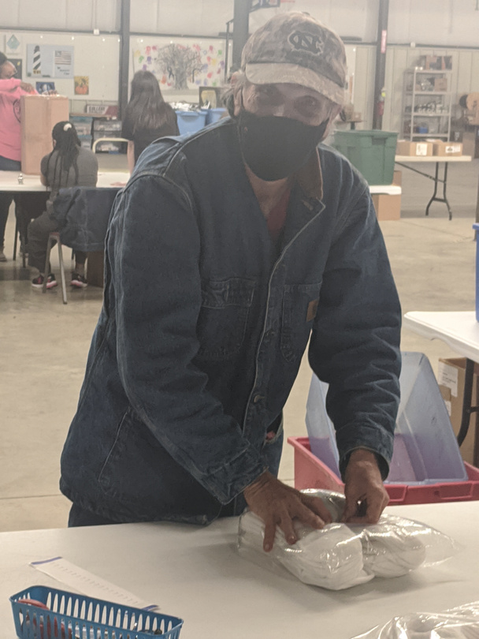
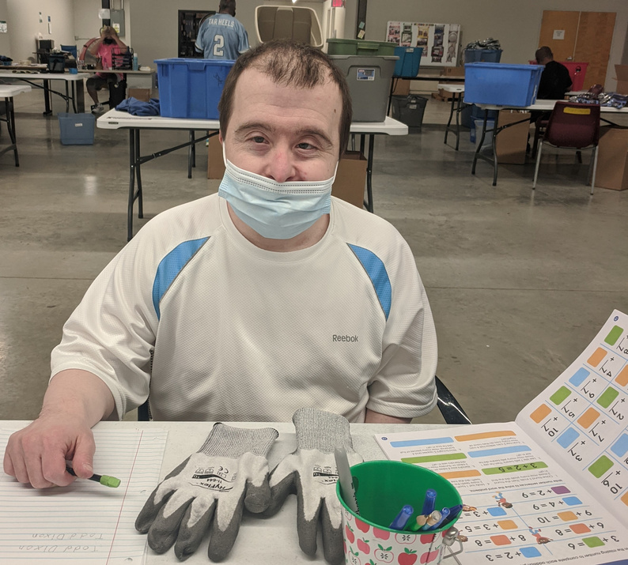
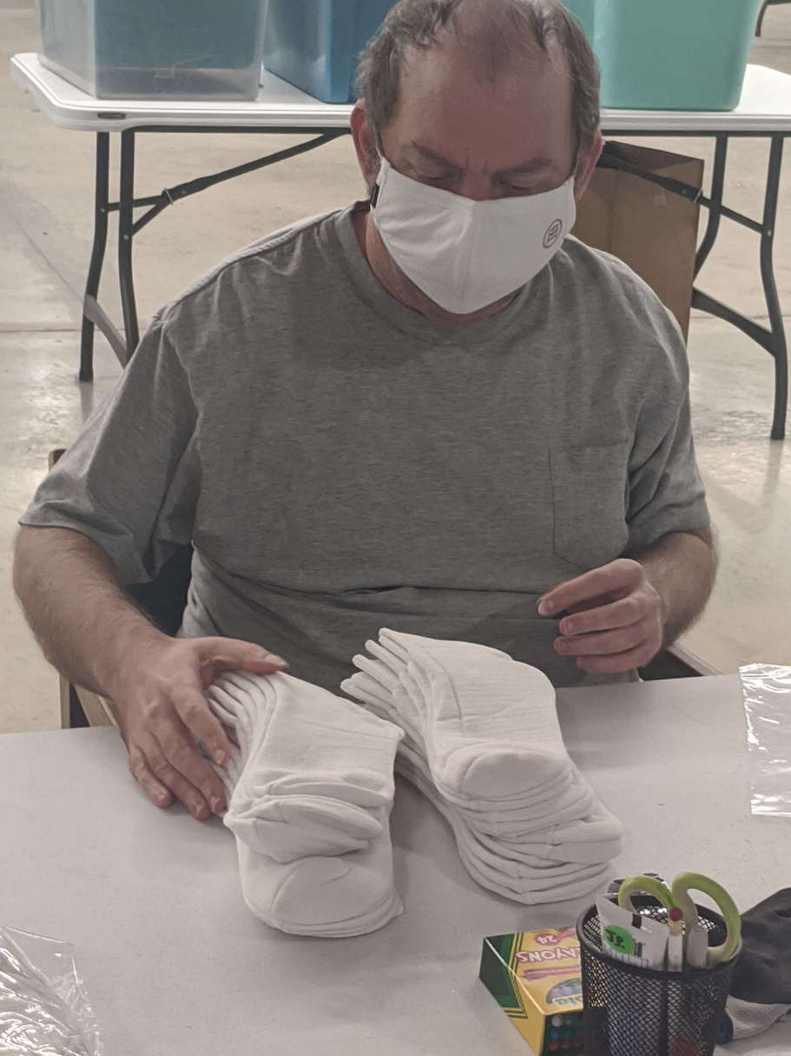
Welcome to the Chatham Trades family!
Corine
Cody
Joe
Tyrone
Peggy
Jason
Todd

Slide 18
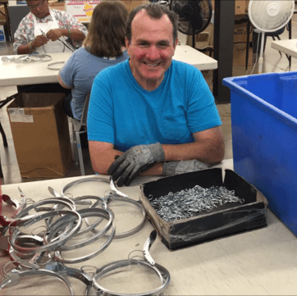
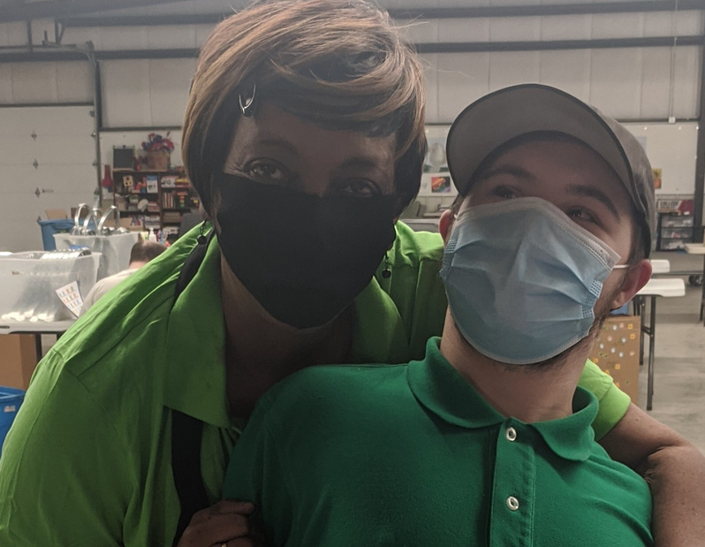
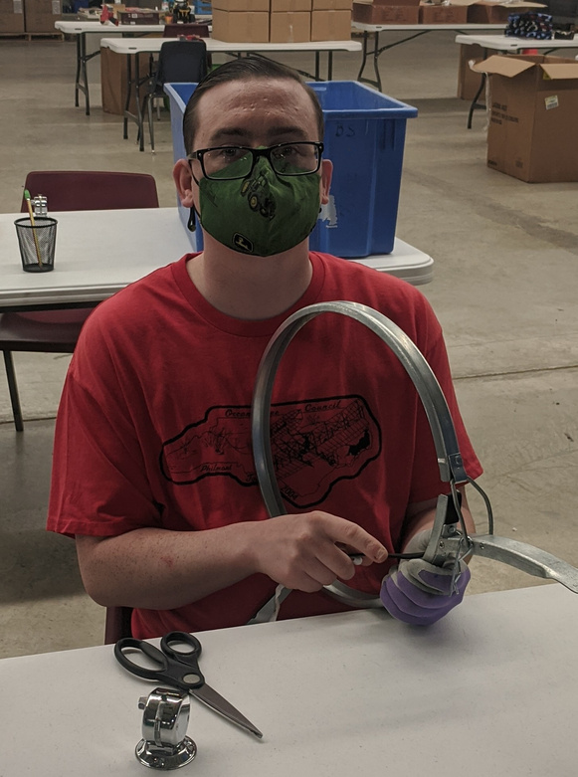
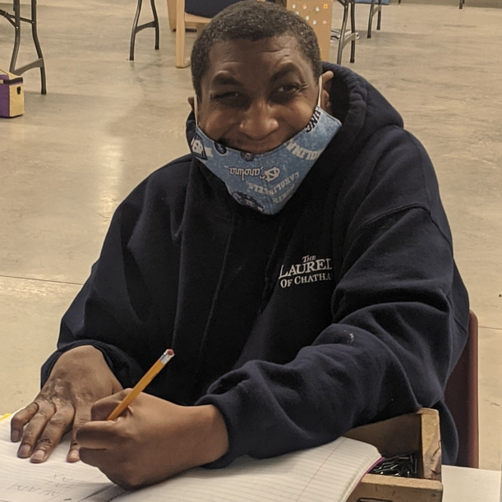
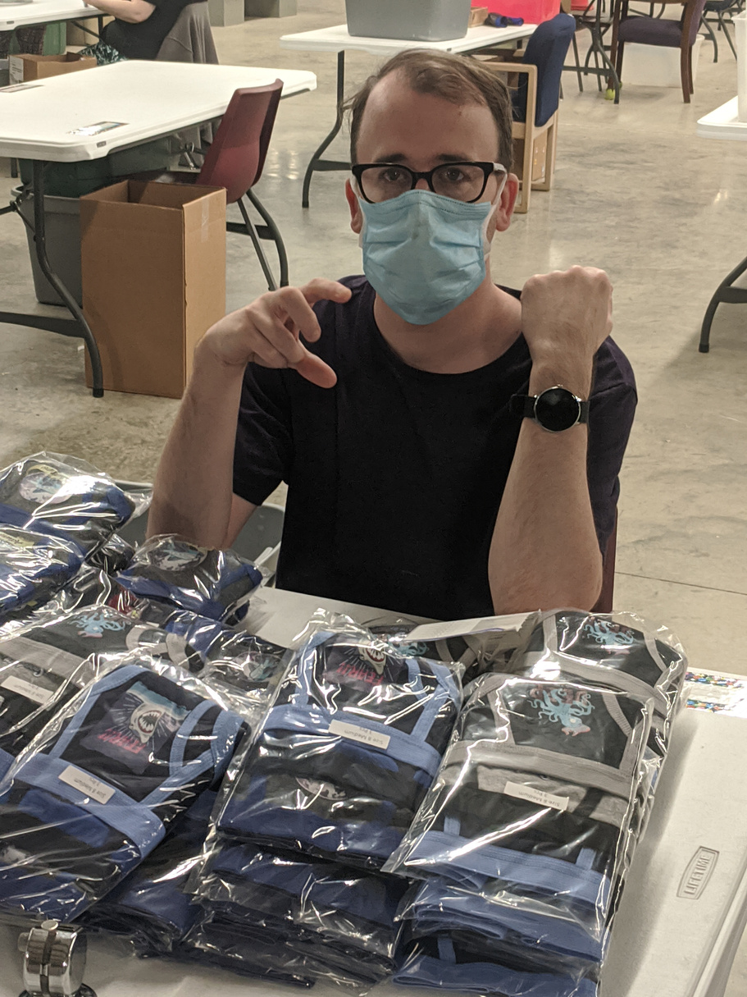
Welcome to the Chatham Trades family!
Harry
Marty
Jeffrey
Garrett
Joel

Slide 19
We are glad you’re here!

