Slide 1
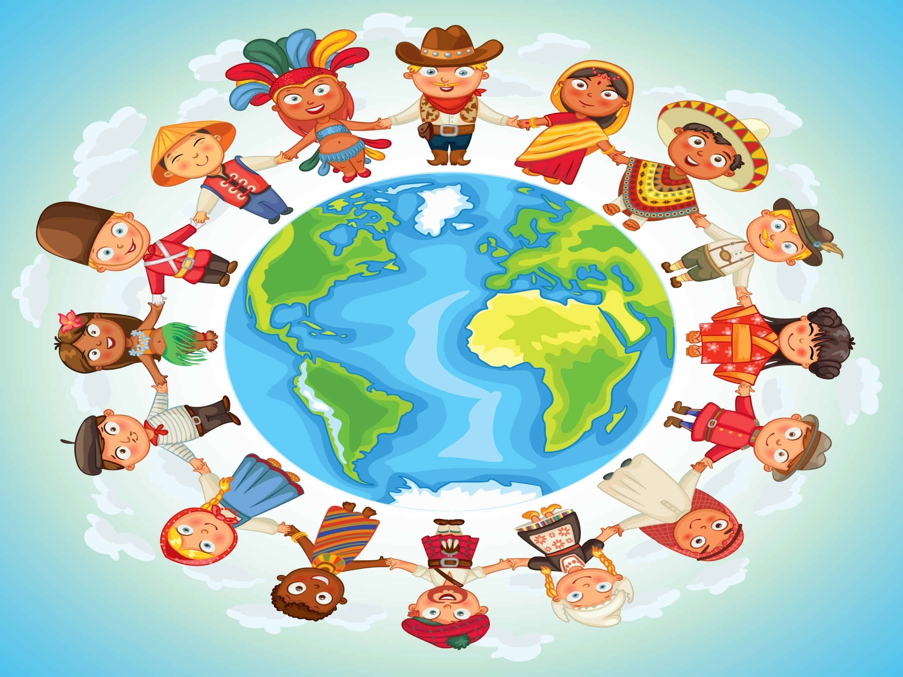
Competency
Cultural Competency

Slide 2
Culture:
Learned traditions, principles and guides of behavior that are shared among members of a particular group.
Codes of behavior, values, and norms, beliefs, customs, communications or “the way we
do things here”. Art, music, food, literature, and clothing are all visible aspects of culture.
*Ethnic groups have cultures
*Businesses have cultures
*Neighborhoods have cultures.
It is dynamic and changes over time.
There is diversity within cultures.
Each person is a member of many cultures!

Slide 3
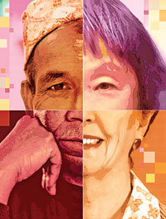
Culture cont…
Culture is manifested in music, literature, lifestyle, painting and sculpture, theatre and film and similar things.
Includes codes of:
Manners
Dress
Language
Religion
Rituals and norms of behavior such as law and morality.

Slide 4
Culture
Is an underlying framework that guides an individual’s perceptions of observed events and personal interactions.
These perceptions help to formulate selection of appropriate responses in social situations.
It is manifested in Learned Behavior.
Family
Spiritual
Work
Age
Neighborhood
Ethnic
Gender
Common Interest

Slide 5
Cultures/community
The term culture is analogous to community, but culture relates more to the behaviors manifested by the community.
People bound together around a common cause create a community, but the minute they begin to establish behaviors around their common cause they become a culture. In a way, culture is the learned and shared way that communities do particular things.
Cultures and communities have many features, but one key ingredient, is they meet with regularity.

Slide 6
Large Societies have subcultures, or groups of people with distinct sets of behavior and beliefs that differentiate them from a larger culture of which they are a part of.

Slide 7
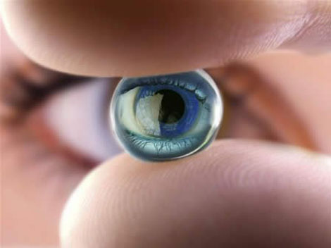
“Cultural Lenses”
Each of us views the world through “cultural lenses” constructed by us or imposed on us by society. Most of the time, we are not aware of our lenses. Most important, we forget to recognize that others wear lenses too; and that their lenses may be different from ours.
The first major step toward successful interaction with others whose lenses are different from our own is to become aware of the presence and the impact of these lenses in our daily attitudes and professional behaviors.

Slide 8
Definitions
Ethnicity – groups in which members share a cultural heritage from one generation to another; one’s geographical origin, group image and a sense of identity derived from contemporary cultural patterns and a sense of history. Many people are of multiple ethnicities.
Race - a classification system based on physical characteristics and generalized conceptions of skin color. A political and social construct that is most often important in societies with a history of oppressing
specific groups.
Racial Identity – one’s sense of group identity or
affiliation and association with others who possess the same racial heritage.

Slide 9
RACE VS ETHNICITY
Race:
Classification of humans according to physical characteristics
*What you are classified as.
Based on:
Skin
Hair
Facial etc.
Ethnicity:
Culturally defined differences between ethnic groups in the society.
*What you identify with.
Based on:
Religion
Language
Customs
Traditions etc.

Slide 10
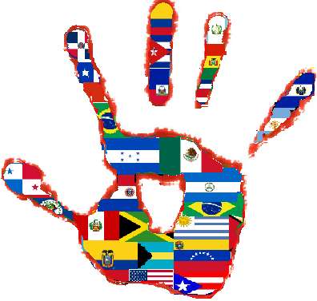
Stereotype
What does it mean?
Example
Stereotypes arise when people act as if all members of a culture or group share some the same characteristics. Stereotypes give a false understanding of others and allow people to observe others in selective ways that confirm prejudice.
Often when people are talking about “Hispanics,” we refer to Mexicans. But, the term “Hispanic” includes people from Mexico, Puerto Rico, Cuba, South America and Central America. The Mexican culture is quite different from the rest of Latin America.

Slide 11
Cultural Competency
Cultural Competency
“The goal of cultural competence is to create a (mental) health system and workforce that are capable of delivering the highest quality care to every patient (consumer) regardless of race, ethnicity, culture, or language proficiency.”
(Betancourt, Green, Carillo & Park, 2005, p.499)
Cultural Competence: Cultural competence is a set of behaviors, attitudes, and policies that come together in an organization to enable it to work effectively in cross-cultural situations.
It is a developmental process that evolves over an extended period.

Slide 12
It requires an organization and its personnel to be able to communicate effectively, and convey information in a manner that is easily understood by diverse audiences, including:
persons of limited English proficiency, those who have low literacy skills or are not literate, and individuals with disabilities.

Slide 14
Five essential elements contribute to a system’s ability to become more culturally competent:
1. Valuing diversity
2. The capacity for cultural self-assessment
3. Consciousness of the “dynamics” inherent when culture
interact
4. Institutionalization of cultural knowledge
5. Developing adaptations to service delivery
reflecting and understanding between and
within cultures.
These five elements must be manifested in every level of
the service delivery system as reflected in attitudes,
policies, structures, and services.

Slide 15
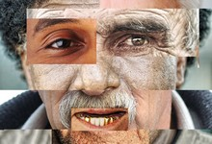
At the Service Level
Related service personnel who are
culturally competent:
learn as much as they can about a consumer’s or family’s culture, while
recognizing the influence of their own background on their responses to cultural differences
include neighborhood and community outreach efforts and involve community cultural leaders if possible

Slide 16
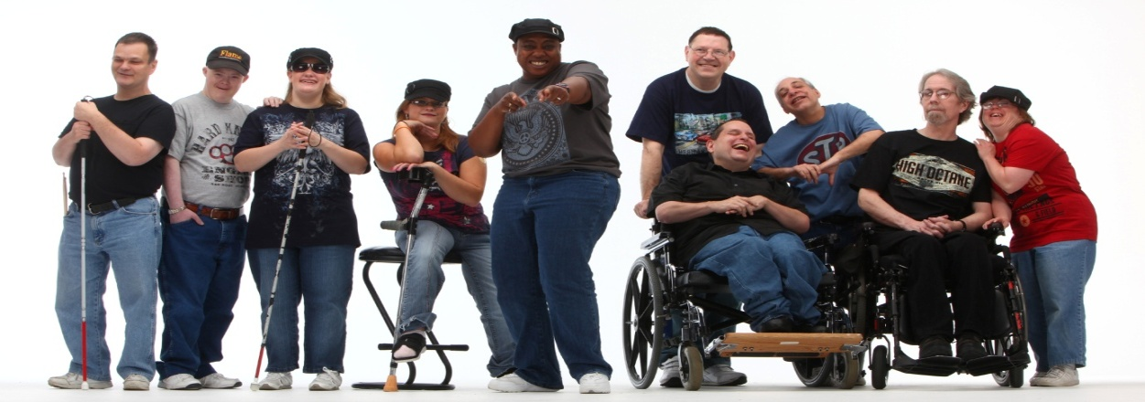
How does this apply to us?
Lack of awareness about cultural differences can make it difficult for both providers and consumers to achieve the best, most appropriate service.
Despite all of our similarities, fundamental differences among people arise from nationality, ethnicity, and culture as well as from family background and individual experiences.

Slide 17
Cultural Diversity in Person Centered Plans
Preferences: What is important TO this person?
Supports: What is important FOR this person?

Slide 18
How Do I manage cultural diversity?
We are generally aware that the first step in managing diversity is recognize it and learning not to fear it.
Since everyone is the product of their own culture, we need to increase both self-awareness and cross-cultural awareness.
There is no book of instructions to deal with cultural diversity, no recipe to follow. But certain attitudes help to bridge cultures.

Slide 19
Cont.
Developing an understanding of our cultural biases, fears and stereotypes, and how they affect our perceptions and interactions with each other are essential in order to provide quality services.

Slide 20
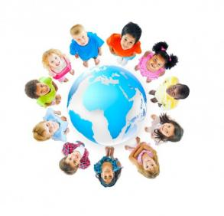
What do we need?
Awareness – consciousness of one’s own attitudes and biases as well as the sociopolitical issues that confront culturally different youngsters
Knowledge – accumulation of factual information about different cultural groups
Skills – integration of awareness competencies to positively impact children from culturally distinct groups
Attitude – belief that differences are valuable and
change is necessary and positive.
Each domain builds successively on the previous
one such that mastery of an earlier domain is
necessary before proceeding to subsequent domains.

Slide 21
