Slide 1
Consumer Rights & Confidentiality Training
Friday, March 2, 2018

Slide 2
Core competencies/ client rights
Foundations of Client Rights
Confidentiality Rules & HIPAA
Abuse and Neglect

Slide 3
foundations
NC General Statute 122-C
MH/DD/SA Rules APSM 30-1
Consumer Rights Rules APSM 95-2

Slide 4
Consumer Rights
Right to dignity
Right to privacy
Right to humane care
Right to freedom from mental/physical abuse, neglect, exploitation
Right to treatment
Right to age-appropriate treatment
Right to an individualized written treatment plan

Slide 5
Consumer Rights Continued
Right to have access to medical care
Right to be informed in advance of potential risks/benefits of program choices
Right to confidentiality
Right to consent to/refuse treatment
Right to be free from unnecessary or excessive medications
Right to be informed of emergency procedures

Slide 6
Consumer rights continued
Right to be free from threat or fear of unwarranted supervision or expulsion
Right to be free from unwarranted search and seizure
Right to exercise all civil rights
Right to file a grievance or complaint
Right to appeal

Slide 7
Chatham trades policy
Assure basic human rights to each consumer. The rights of consumers will not be restricted without due process.

Slide 8
Chatham trades procedures
Confidentially of Information
Proper release of confidential information
Appropriate access to confidential information by the staff, consumer and others
Each consumer will have an individualized written service plan
Refrain as much as possible from physical restraints/seclusion
Consumer can refuse treatment at any time

Slide 9
Procedures continued
No excessive/unnecessary medication
No physical/emotional/verbal abuse of consumers
No threats
Force only for restraint in emergency situations
Consumers’ lockers are private space
Consumers entitled to phone calls in private

Slide 10
Procedures continued
Staff may search a consumer only under certain conditions and must be authorized by the Executive Director
Parents/guardians must be notified of any searches
Staff shall not engage in any romantic or sexual discussions or behaviors with consumers
Staff are prohibited from engaging in business transactions with consumers

Slide 11
Procedures continued
Staff prohibited from borrowing assets or property from consumers
Staff prohibited from asking consumers to perform tasks for them or members of their family
Staff shall not give or receive gifts of a substantial nature to/from consumers

Slide 12
Procedures continued
All consumers have the right to file a grievance
All consumers will be informed of the due process for filing a grievance at the time of admission
Resolve issues with Hab. Tech./Unit Supervisor
Address with Assistant Director then Executive Director
Board of Directors
Cardinal Innovations’ Client Rights Committee
Disability Rights North Carolina

Slide 13
Procedures continued
Consumers will be given a written copy of their rights
Staff are required to explain rights to consumers
Explanation of any rules consumers are expected to follow
All new staff shall receive information about the rights of consumers and engage in periodic trainings.

Slide 14
Confidentiality /hipAa
What is HIPAA?
The Health Insurance Portability and Accountability Act of 1996 began to help individuals keep their health insurance coverage as they moved from one job to another.

Slide 15
Confidentiality /hipAa
What we think of as HIPAA is only a small part (Title II) of this act, which protects privacy, confidentiality, integrity, and availability of an individual’s healthcare information.

Slide 16
Confidentiality /hipAa
In the past, there have been few or weak penalties for breaching confidential health information.
With the passage of the HITECH (Health Information Technology for Economic and Clinical Health) Act in 2009 as part of the American Recovery and Reinvestment Act, things have changed.

Slide 17
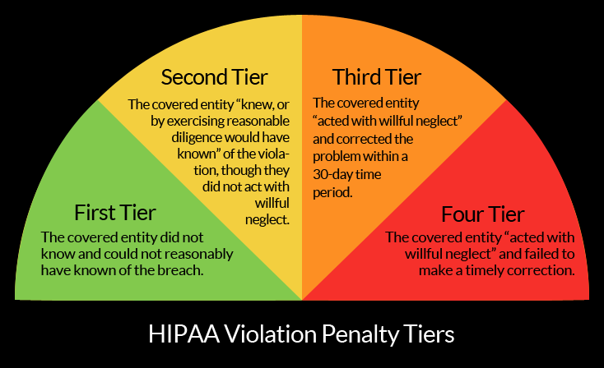
Confidentiality /hipAa

Slide 18
Confidentiality /hipAa
HITECH Act extends civil and criminal liability under HIPAA to business associates of other HIPAA covered entities, includes provisions for imprisonment of violators, and clarifies that criminal penalties may apply to an individual or employee of a covered entity that obtains PHI (protected health information) without authorization.

Slide 19
Confidentiality /hipAa
Penalties can range from $10,000 to $50,000 per violation.
The minimum penalty for a violation caused by willful neglect is $50,000.
The Office of Civil Rights has the discretion to impose penalties in cases of violations due to willful neglect instead of first attempting to resolve the matter through informal means.

Slide 20
Confidentiality /hipAa
There is now a new rule that any improper use or disclosure of PHI is presumed to be a breach unless it is proven that there was a low probability that the PHI was compromised.
Another new rule determines whether patients, the government, and the media must be informed of any breaches of unsecured PHI.

Slide 21
Confidentiality /hipAa
Confidential information cannot be released without a signed authorization of release (must be signed by consumer or consumer’s guardian)
If consumer is signing, must be told what the release is for and that they can withhold consent
Releases are good only for one year
People who can release information: Executive Director, Assistant Director
Release will be documented in consumer’s file

Slide 22
Confidentiality /hipAa
Shredding documents with full names on them.
Not leaving documents with full names where others can see them.
Not using full names in emails (unless encrypted to HIPAA standards), publications, notes that the public may see, etc.
Double lock any protected health information.
Don’t give out any information to someone you do not know over the phone.
If you are not sure, don’t do it until you find out if its OK.

Slide 23
Confidentiality /hipAa
Can we ever disclose information without consent?

Slide 24
When there is a medical or psychiatric emergency involving consumer health or safety or the safety of others.
When required by law to report instances of neglect or abuse of a child or disabled adult.
When responding to a court order or participating in a commitment proceeding.
When required by North Carolina Administrative Code to disclose physician information due to an incident that would cause health risk to other persons.
To the NC Department of Corrections.

Slide 25
Abuse and neglect
Who do I report abuse, neglect, or exploitation to?
Immediately report to supervisor.
Supervisor will make a report to DSS, APS, and consumer’s case manager and an IRIS report will be filed.
Report will be filed within 24 hours.

Slide 26
Abuse and Neglect Continued
If you make a report your identity will not be disclosed without your consent except to investigator/prosecutor or when disclosure is legally compelled.
Employee making report in good faith is immune from any civil liabilities.
Staff have a duty to report under NC laws.

Slide 27
Abuse and neglect continued
What is reported?
Any suspected abuse of a client. You do not have to see the abuse, see any marks, or even be sure that the abuse took place.
Things to report: hitting, pushing, shoving, forcing food or medication, not giving food or medication, isolation, name calling, sexual abuse, any rights violations, etc.

Slide 28
Abuse and neglect continued
What if I see it happen?
Staff have a responsibility to intervene and prevent, if possible, any instance of abuse or neglect by anyone towards a consumer.
This does not negate your responsibility to report such abuse or neglect. If you see a co-worker being abusive and you approach them and discuss it, you still must make a report to your supervisor.

